Slide 1
Trends in the Dairy industry
4/29/2020

Slide 2
Topics
“Exploratory analysis of Wage Distribution” by Serafim Petrov
Demographics of US Farm Workers by Sonya Williams
Challenges of Dairy farms and farm living in the US by Sarah Lin
Dairy Farms Operated by Women by Jermaine Grandison
Trends in Securities by Ryan Fitzmaurice

Slide 3
Dairy’s economic outlook 2017
There are 40,00 dairy farms in the United States.
The top five dairy states in the United States: 1. California 2. Wisconsin 3. New York 4. Idaho 5. Texas
In 2017, total U.S. milk production was valued at $38.1 billion.
Agricultural commodities sales 1. Cattle ($66.5 billion) 2. Corn ($46.4 billion) 3. Soybeans ($38.7 billion) 4. Milk ($38.1 billion)
Total U.S. milk production increased to 215.5 billion pounds in 2017 comparing to 2016

Slide 4
Wages and Employment
In 2017 there were 139,240 employees in 129 different positions
Minimum annual wage: $20,240
Maximum annual wage: $204,020
Average wage : $44890

Slide 5
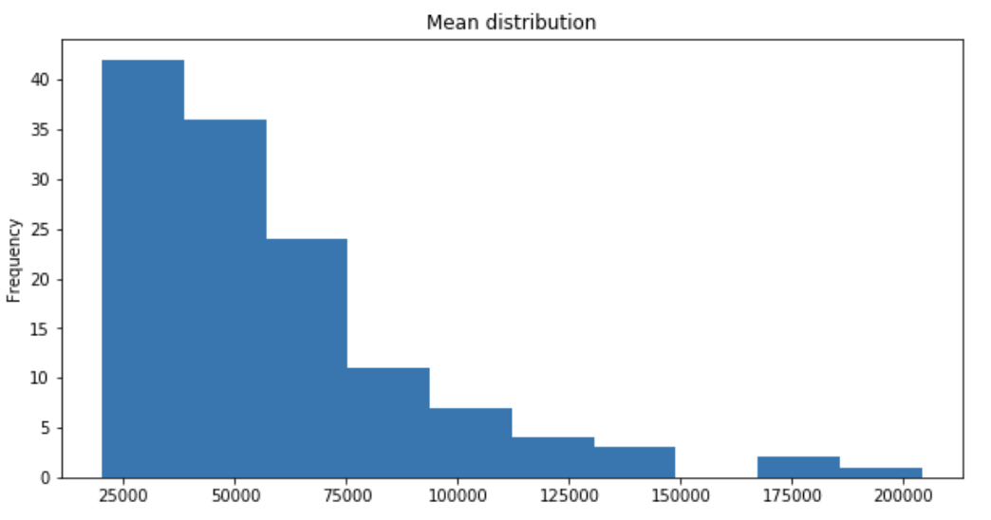
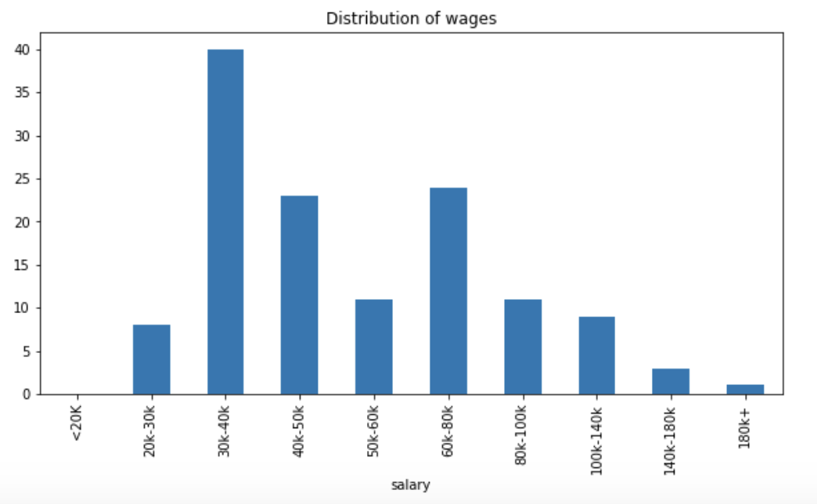
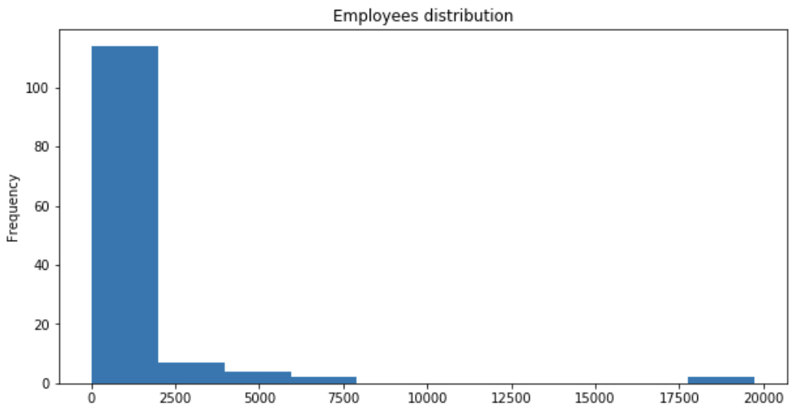
Wages
Wages Distribution
Wages range
Employees Distribution

Slide 6
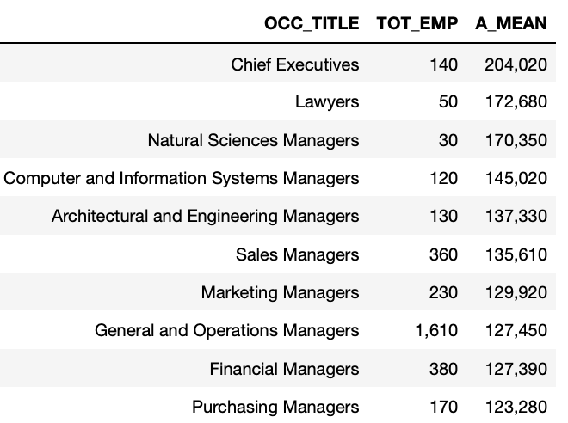
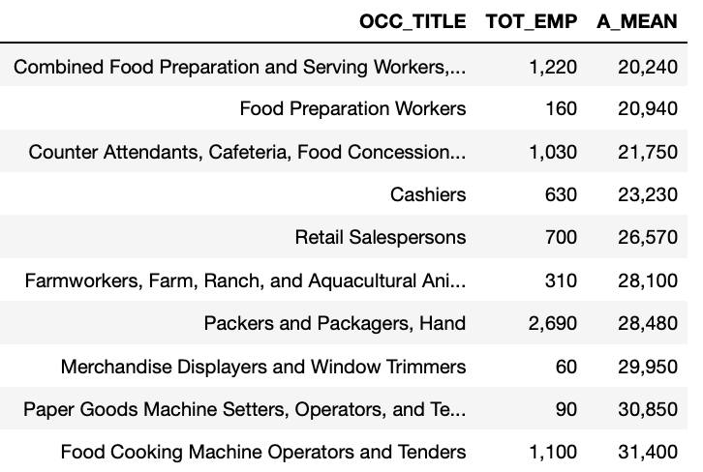
wages in different positions
Top 10 Occupations
Bottom 10 occupations

Slide 7
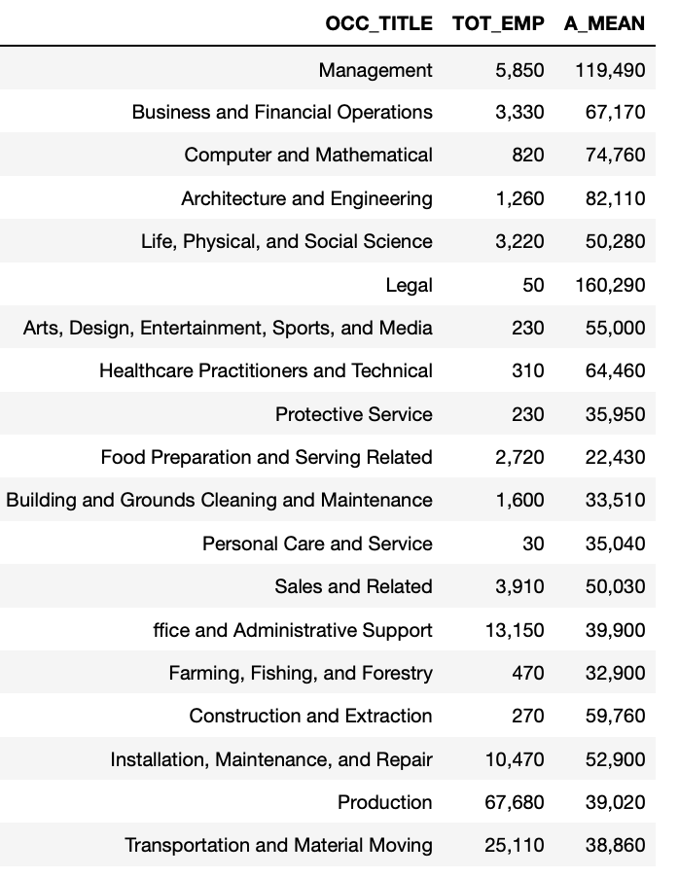
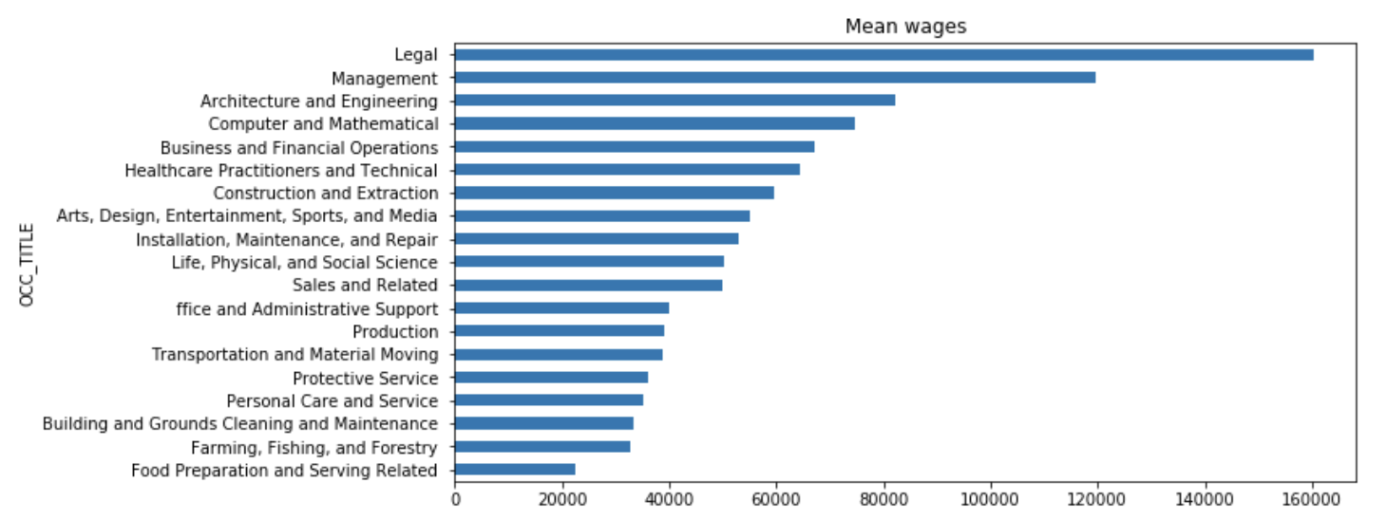
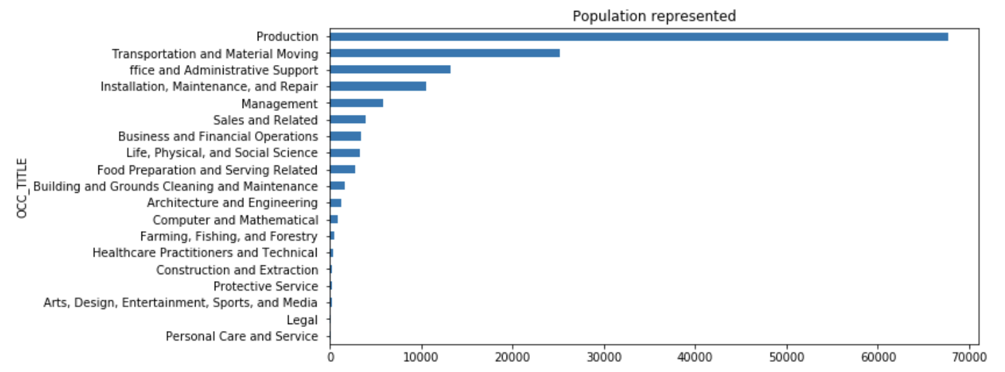
Wages in group occupations

Slide 8
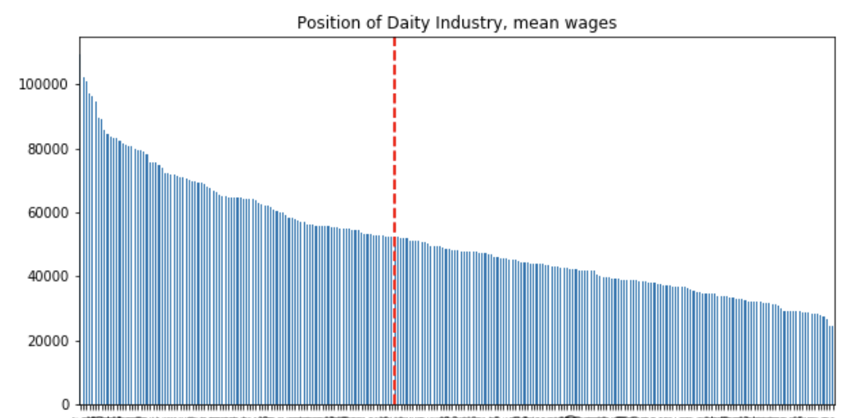
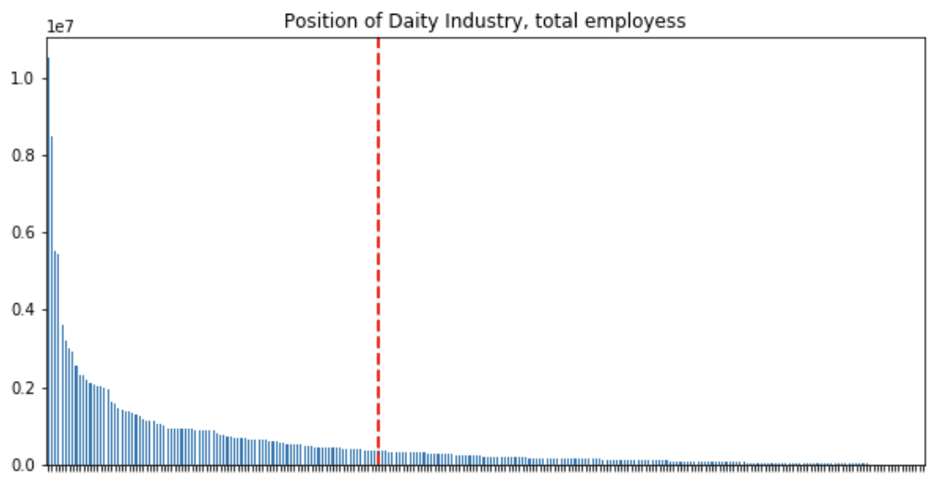
Position of dairy industry in the us economy 2017

Slide 9
Challenges
Dairy Farms and Farm living in the US

Slide 10
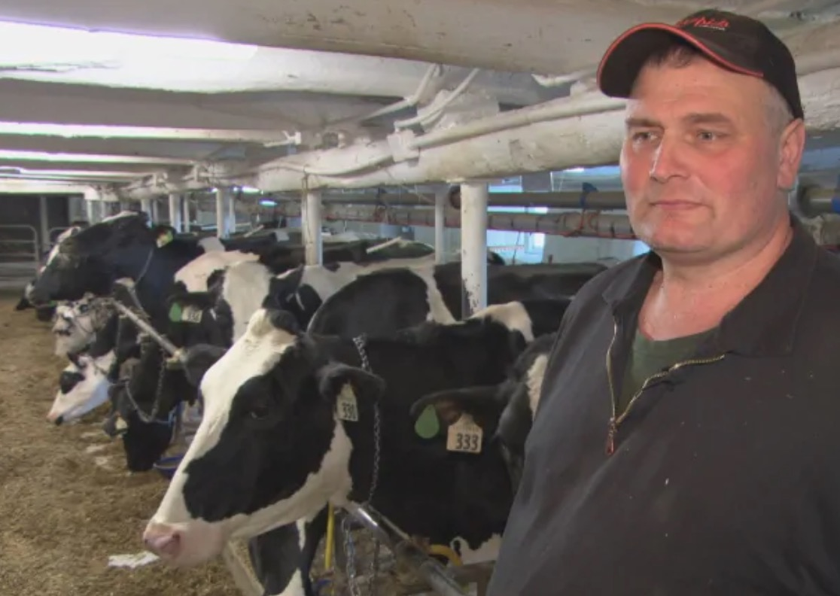
Introduction
In this sub-topic, my research focuses on two of the many challenges that most modern US dairy farmers face in terms of farm living and household, in hopes to find out how these challenges may affect dairy farmers and the farm industry as a whole.

Slide 11
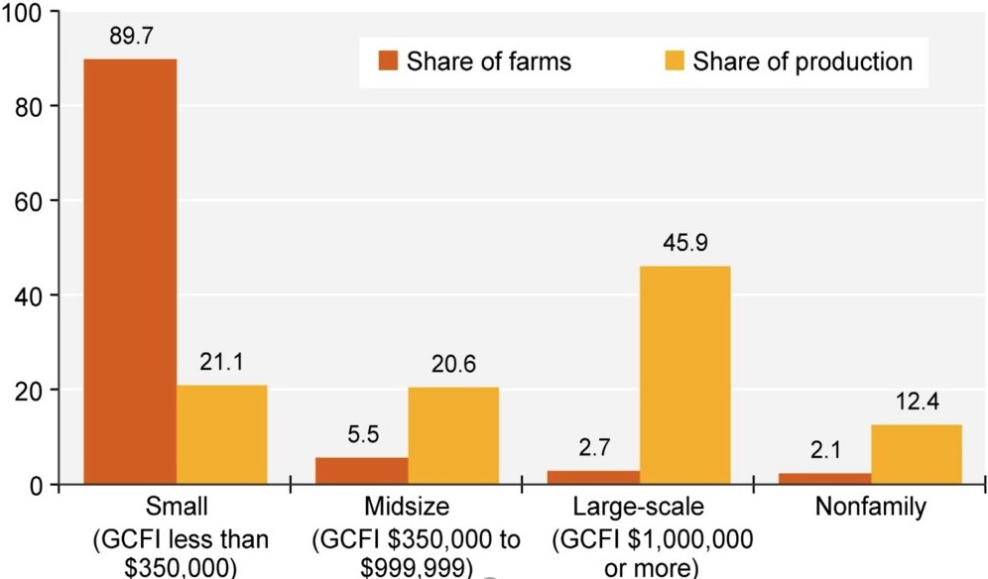
Challenges
C1: Most dairy farms are small family farms, BUT most productions are from large family farms
Family farms: the majority of the business is owned by the farmer and individuals related to the farmer
Family farms accounted for nearly 98% of U.S. farms in 2018.
Small family farms accounted for 90 percent of all U.S. dairy farms.
Large-scale family farms: 3% of farms but 46% of the value of production.

Slide 12
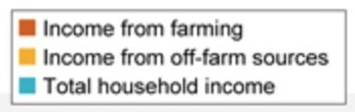
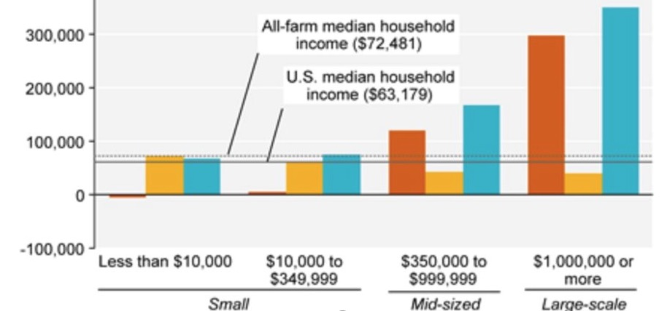
Challenges
C2: Most dairy farmers receive off-farm income, BUT small farmers/farms depend on off-farm income for survival
Even though median household income among all dairy farm households ($72,481) exceeded the median for all U.S. households ($63,179) in 2018.
Farm sizes and household weight matter
Most dairy farm households (> 50% are small farms) rely on off-farm sources for the majority of their household income

Slide 13
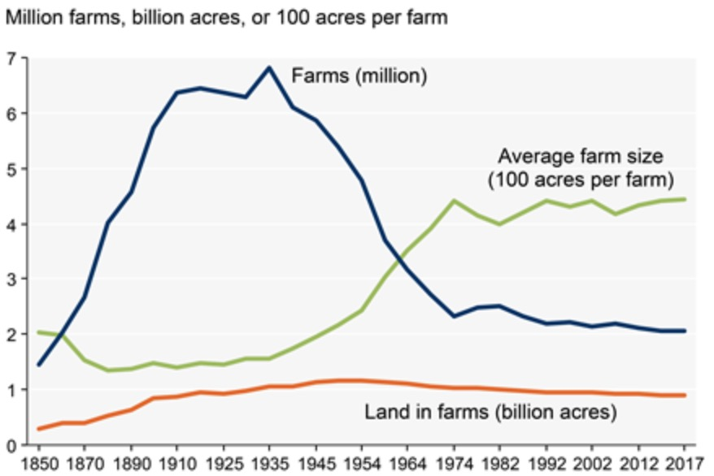
As a result....
The farming industry has been leveled off for almost 50 years
Increased number of failed farms:1935-2017
Less farms but bigger farmland
About 444 acres in 2017 per farm versus 155 acres per farm in 1935.
Only about 2.05 million farms are currently in operation.

Slide 14
Women Operated
Dairy Farms

Slide 15
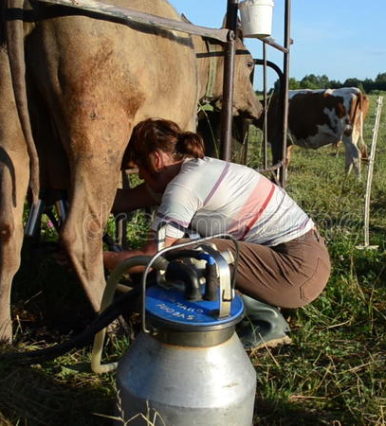
Introduction
There has been a great deal of research on the gender wage gap in the non-farm economy over the past decades. My research explores and provides empirical data showing women operated Dairy Farms with an interest in finding out the percentage of farms operated by women.

Slide 16
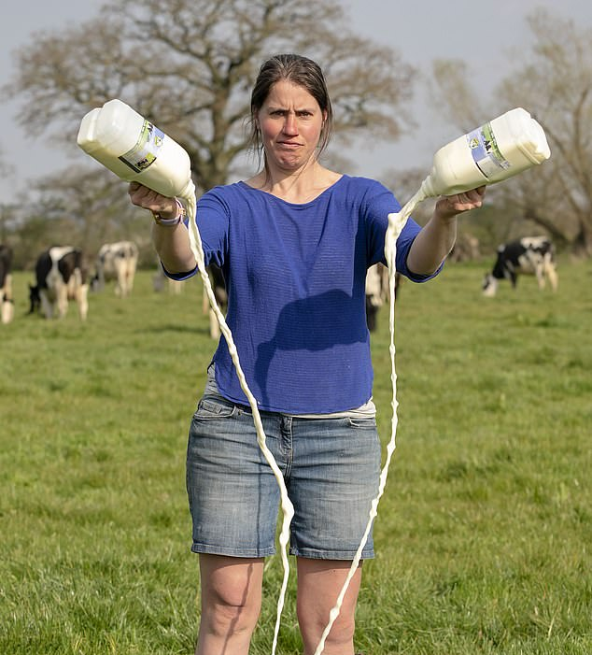
Using the 2012 U.S. Census of Agriculture we show that farms operated by women earn forty percent less farm income than farms operated by men after controlling for farm and operator characteristics

Slide 17
Perpetual Gender Bias
While Research in the United States is thin, work to current date suggests that continued structural and cultural discrimination against women landowners and farmers is prevalent. Our research found that women are being underserved within the areas of Dairy Agriculture Education which eventually furthers gender inequality in dairy farming.

Slide 18
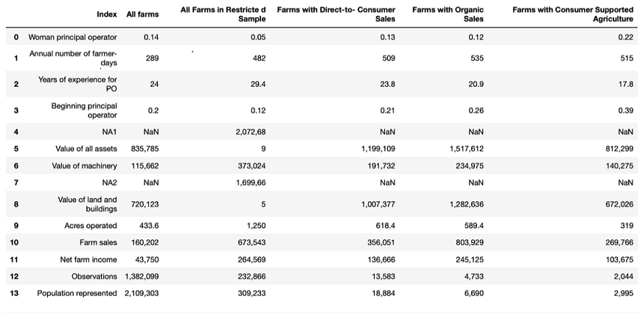

Slide 19
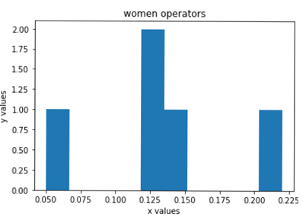
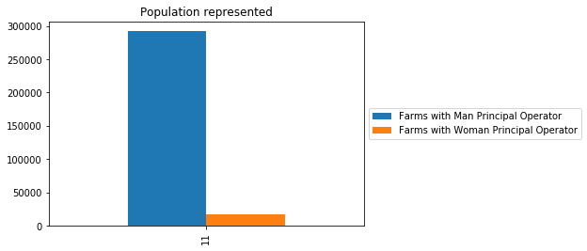
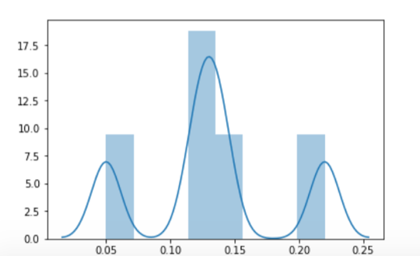

Slide 20
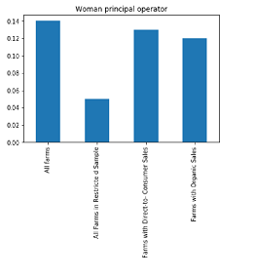

Slide 21
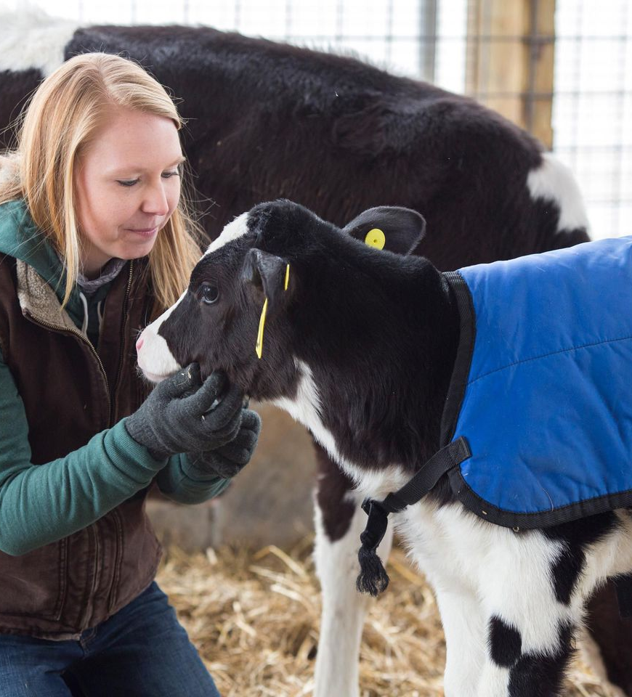
Conclusion
For this specific sub-topic, our research found that Dairy Farming is one of the most unequal professions in the United States proving that only 0.14% of Dairy Farms are operated by women. Another finding was that farms located on the East and West Coasts were disproportionately likely to be owned and operated by women and are more likely to be community supported with a net farm income of $ 264,569.00

Slide 22
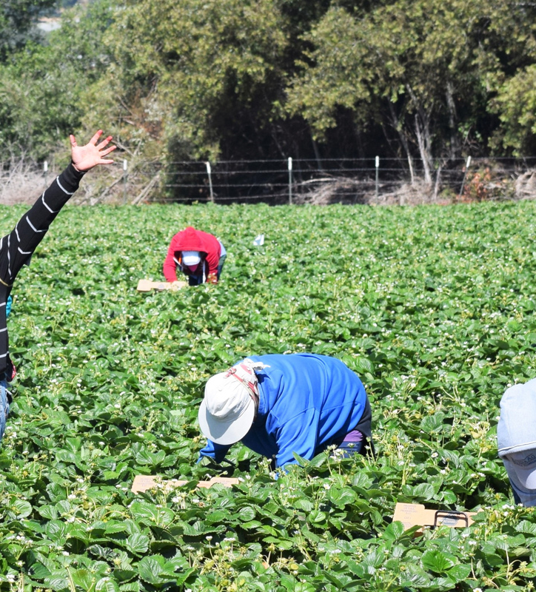
INTRODUCTION
Hired farmworkers make up less than 1 percent of all U.S. wage and salary workers, but they play an essential role in U.S. agriculture. They are found in a variety of occupations, including field crop workers, nursery workers, livestock workers, graders and sorters, agricultural inspectors, supervisors, and hired farm managers.

Slide 23
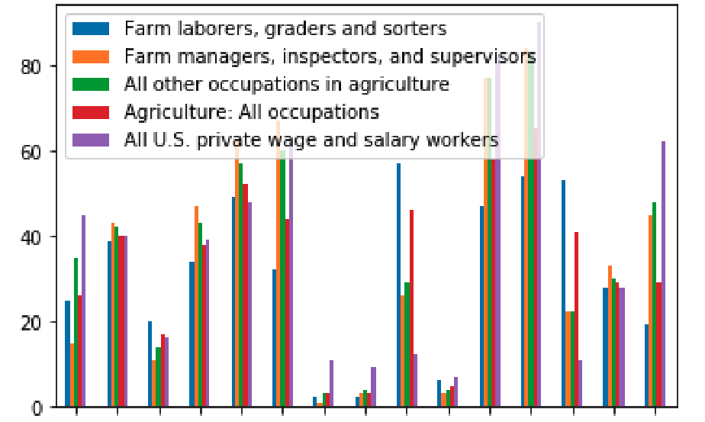
DEMOGRAPHICS OF U.S. FARMWORKERS
DEMOGRAPHIC CHARACTERISTIC OF HIRED FARMWORKERS AND ALL WAGE AND SALARY WORKERS - 2017
FEMALE
AVG AGE IN YEARS
WHITE, NOT HISPANIC
HISPANIC: MEXICAN ORIGIN
LACKING H.S. DIPLOMA
SOME COLLEGE
HISPANIC: OTHER
OTHER, NOT HISPANIC
U.S. / PUERTO RICO Born
HIGH DIPLOMA / EQUIVALENT
OVER AGE 44
BLACK, NOT HISPANIC
UNDER AGE 25
MARRIED
U.S. CITIZENS

Slide 24
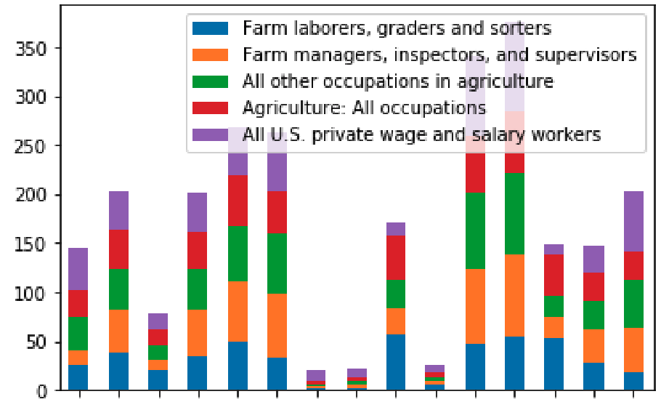
DEMOGRAPHICS OF U.S. FARMWORKERS
DEMOGRAPHIC CHARACTERISTIC OF HIRED FARMWORKERS AND ALL WAGE AND SALARY WORKERS - 2017
FEMALE
AVG AGE IN YEARS
WHITE, NOT HISPANIC
HISPANIC: MEXICAN ORIGIN
LACKING H.S. DIPLOMA
SOME COLLEGE
MARRIED
OTHER, NOT HISPANIC
HISPANIC: OTHER
BLACK, NOT HISPANIC
U.S. / PUERTO RICO Born
H.S. DIPLOMA / EQUIVALENT
OVER AGE 44
U.S. CITIZENS
UNDER AGE 25

Slide 25
DEMOGRAPHICS OF U.S. FARMWORKERS
PERCENT OF FEMALES IN EACH POSITION

Slide 26
DEMOGRAPHICS OF U.S. FARMWORKERS
PERCENT OF CAUCASIAN (NON-HISPANIC) IN EACH POSITION

Slide 27
DEMOGRAPHICS OF U.S. FARMWORKERS
PERCENT OF AFRICAN AMERICAN (NON-HISPANIC) IN EACH POSITION

Slide 28
DEMOGRAPHICS OF U.S. FARMWORKERS
PERCENT OF OTHER ETHNICITIES (NON-HISPANIC) IN EACH POSITION

Slide 29
DEMOGRAPHICS OF U.S. FARMWORKERS
PERCENT OF HISPANIC – MEXICAN ORIGIN IN EACH POSITION

Slide 30
DEMOGRAPHICS OF U.S. FARMWORKERS
PERCENT OF U.S. OR PUERTO RICAN BORN WORKERS IN EACH POSITION

Slide 31
DEMOGRAPHICS OF U.S. FARMWORKERS
PERCENT LACKING A HIGH SCHOOL DIPLOMA

Slide 32
DEMOGRAPHICS OF U.S. FARMWORKERS
PERCENT WITH SOME COLLEGE EDUCATION

Slide 33
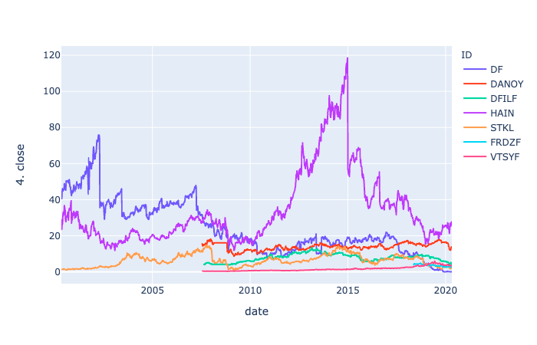
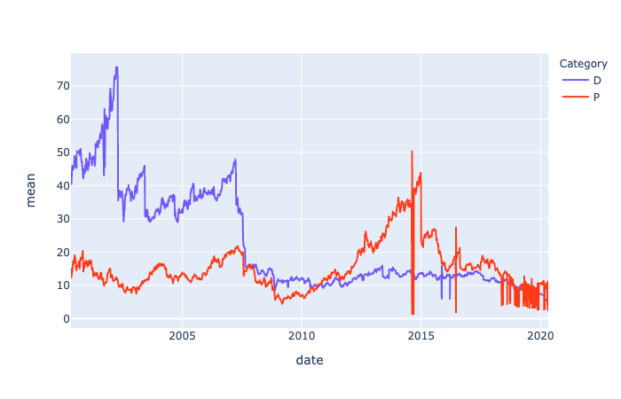
Trends in STOCKS:
Program Overview:
The program gathers data from the present day, extending back 20 years to determine the price of desired securities. On a daily basis, the program calls a third party service for data and the results are stored in a central database.
The database passes tables to the program to enable visualization.
Output: Weekly Close, Mean of Aggregate Industry Quotes
Future Developments:
One of the recent developments to monitor is the emergence of plant based products. It has reported that 'Oatly', a large manufacturer of Oat milk is preparing an IPO.

